Slide 1

BRITISH AIRWAYS
TASK 2: Predicting customer buying behaviour

Slide 2
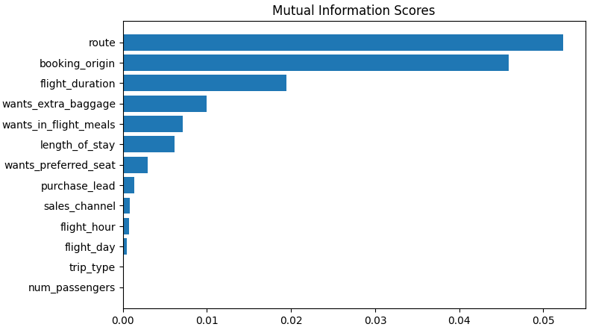
Predictive Modeling Analysis for Customer Booking Data
Model Performance:
Random Forest:
Accuracy : 84.74%
AUC : 0.74
XGBoost:
Accuracy: 84.28%
AUC : 0.71
Top 5 features which Influence
Customer buying behavior:
route
booking_origin
flight_duration
wants_extra_baggage
Wants_in_flight_meals
CONCLUSION: Continued refinement and optimization are necessary to develop a robust predictive model.

